Slide 1
Employee Data Analysis using Excel
JOSHIKA.M.k
122202166 , EEB7286DD221474A50244B68D2066CA
B. COM corporate secretarship
ANNA AADARSH COLLEGE FOR WOMEN'S
STUDENT NAME:
REGISTER NO:
DEPARTMENT:
COLLEGE

Slide 2
PROJECT TITLE
Employee Performance Analysis using Excel

Slide 3


AGENDA
Problem Statement
Project Overview
End Users
Our Solution and Proposition
Dataset Description
Modelling Approach
Results and Discussion
Conclusion
3/21/2024 Annual Review

Slide 4

PROBLEM STATEMENT
problem statement is a tool used in project management to describe a problem that arises during a project's execution. It should identify a specific problem, explain its impact, and propose a solution.
problem statement is a high level summary of a problem and is a powerful communication tool. It also helps a business analyst maintain control when conducting analysis.

Slide 5

PROJECT OVERVIEW
Employee data analysis is the process of collecting, analyzing, and interpreting data about employees to improve decision-making, enhance productivity, and create a better workplace environment.
.

Slide 6

WHO ARE THE END USERS?
Employees
Employers
Organaization
Individual
Customers

Slide 7

OUR SOLUTION AND ITS VALUE PROPOSITION
Filtering -missing
Chats - visualize, report
Pivot table- summary
Conditional techniqes- identify
Filtering

Slide 8
Dataset Description
Employee data set - kaggle
26 features
9 features
Employee id
Name - text
Rating- numerical
Performance - text
Gender - female, male
Business unit - text
Business type - text

Slide 9

THE "WOW" IN OUR SOLUTION
Emplyee data set - new or unique features is,
Calculating performance categories
Using formula for performance ( high or low)
3/21/2024 Annual Review
9

Slide 10
MODELLING
Data collection
Data cleaning
Datavselecting
Performance formula (high or low)
Creating pivot table
Creating pivot chart
10

Slide 11
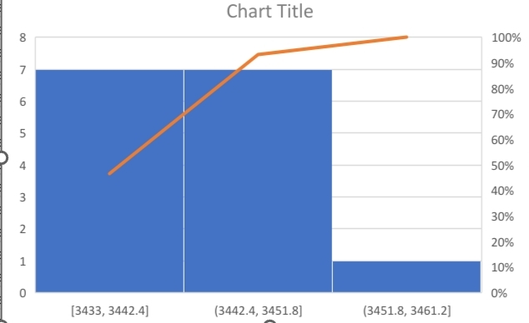
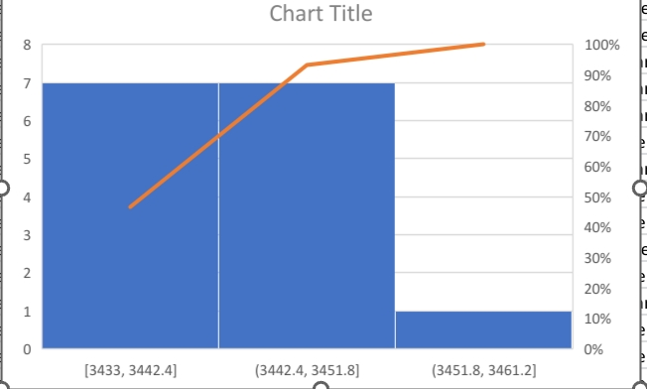
RESULTS
11

Slide 12
conclusion
These are the employee data set ( performance level)

